Slide 1



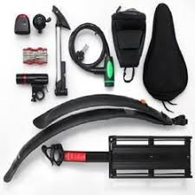



ADVENTUREWORKS
By- Priyanshi
Course project :Maven Analytics

Slide 2

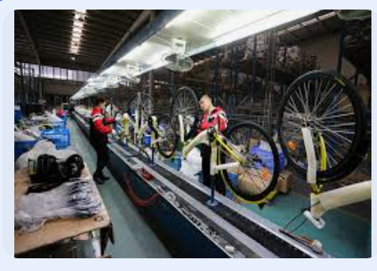


ADVENTUREWORKS
A Global manufacturing Company produces Cycling Equipment and accessories.

Slide 3

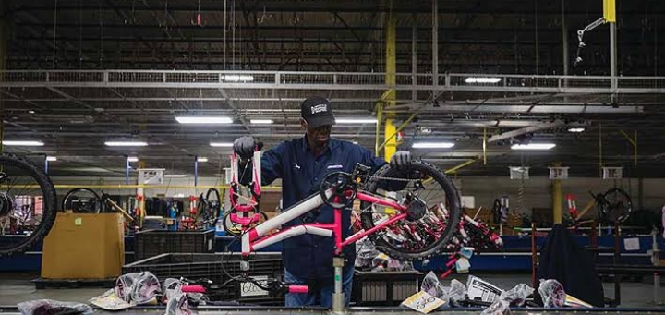
Objective
Data Integration and Transformation - Connect to raw CSV files containing transaction, product, customer, and sales territory data, and apply advanced data cleaning techniques to prepare it for analysis.
Relational Data Modeling - Construct a robust relational data model that establishes clear relationships between datasets, ensuring seamless data flow and accurate analytics.
. Advanced Calculations with DAX - Develop dynamic KPIs and measures using DAX to track essential metrics like sales, revenue, profit, and returns, providing actionable insights into business performance.
Interactive Dashboard Design - Build an intuitive and visually compelling dashboard that allows management to compare regional performance, analyze product-level trends, and identify high-value customers, empowering data-driven decisions.

Slide 4

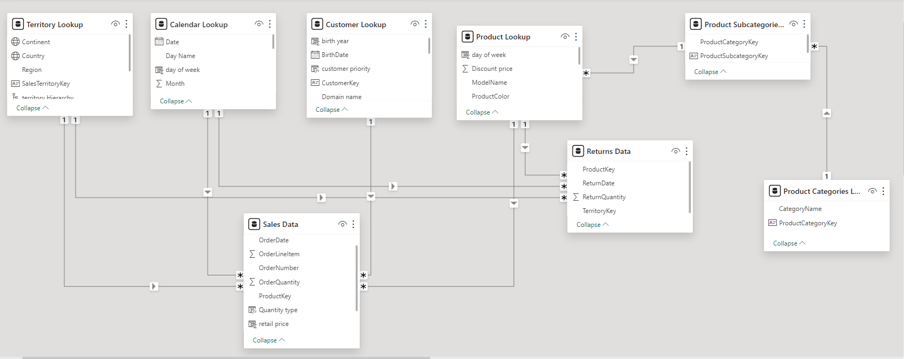
Models view and relationship

Slide 5



DASOAHBRD OVERVIEW
The Revenue Dashboard provides a comprehensive view of the company's financial performance by focusing on total revenue, revenue trends over time, and monthly targets. This dashboard enables the management team to track financial growth, evaluate performance against set goals, and understand revenue patterns across different periods.
REVENUE ANALYSIS
The Product Performance Dashboard provides insights into how individual products are performing, focusing on orders by category and return rates. This dashboard is essential for managing product quality and customer satisfaction by highlighting which products drive sales and which may require improvement.
PRODUCT ANALYSIS
The Orders Dashboard focuses on understanding customer demand through total orders, category breakdowns, and monthly targets. This dashboard serves as a valuable tool for identifying demand patterns, managing inventory efficiently, and ensuring that the business can meet customer needs effectively.
CUSTOMER ANALYSIS

Slide 6
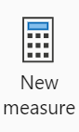
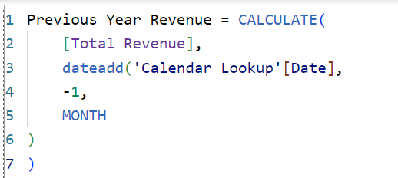
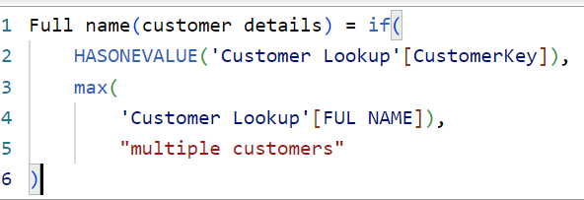
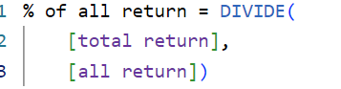
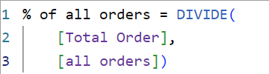
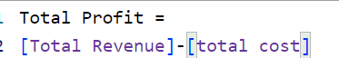


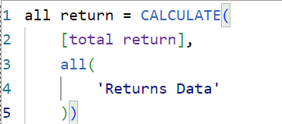
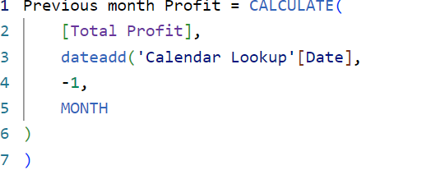
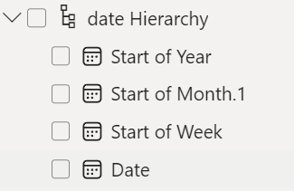
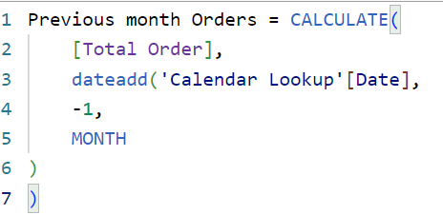
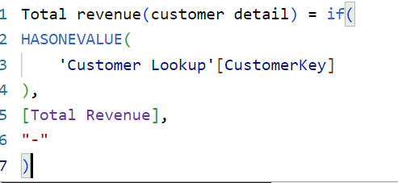
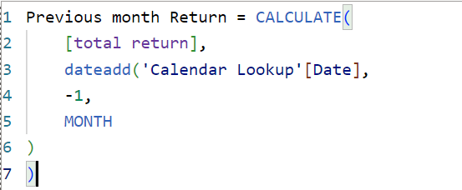

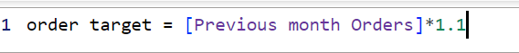
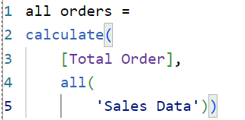
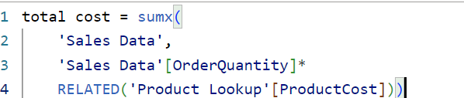
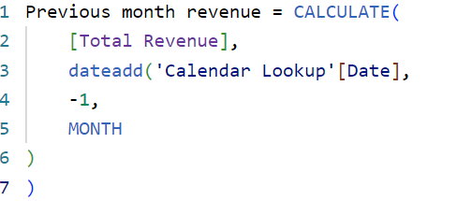
MEASURES AND HIERARCHIES

Slide 7
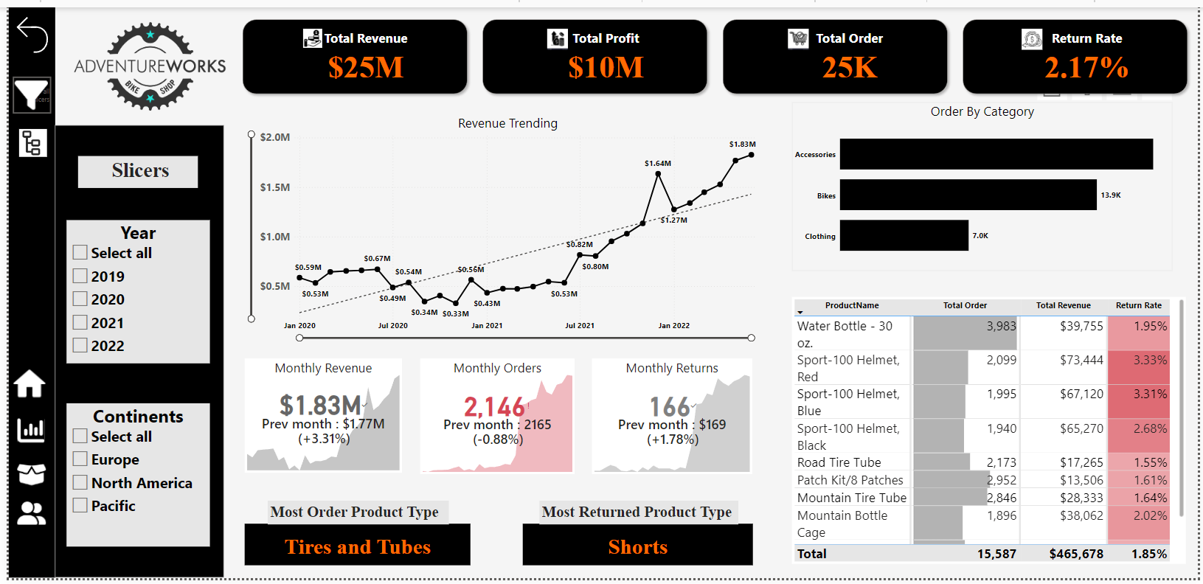

Slide 8

OBSERVATIONS
1. Overall Performance Metrics:
- Total Revenue: The company achieved a total revenue of $25 million.
- Total Profit: The overall profit stands at $10 million, showcasing a healthy profit margin.
- Total Orders: The business processed 25,000 orders.
- Return Rate: The product return rate is 2.17%, indicating a relatively low percentage of returns.
3. Monthly Performance:
- Monthly Revenue: Current monthly revenue is $1.83 million, a +3.31% increase from the previous month’s $1.77 million.
- Monthly Orders: There were 2,146 orders, a slight decrease of -0.88% from the previous month’s 2,165 orders.
- Monthly Returns: A total of 166 returns were recorded, an increase of +1.78% compared to the previous month’s 169 returns.
2. Revenue Trending:
- Revenue has shown significant growth over the period, peaking at $1.83 million in January 2022. Notable growth points include increases from $0.53 million in January 2020 to $0.98 million in July 2021.
- A steady upward trend can be observed, with prominent milestones at $1.27 million in July 2021 and $1.68 million in July 2021.

Slide 9
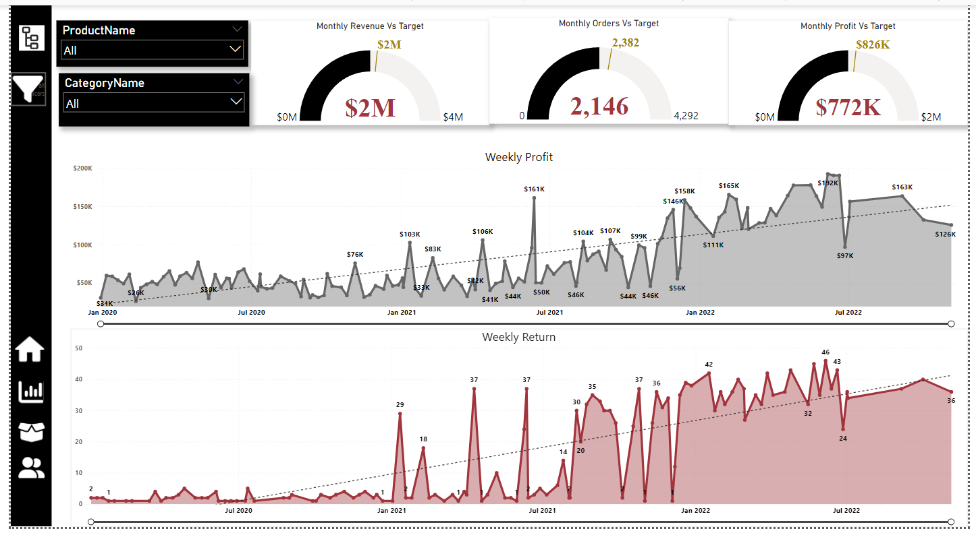

Slide 10

OBSERVATIONS
1. Monthly Performance Against Targets:
- Monthly Revenue: The current revenue is $2 million, meeting the target of $2 million.
- Monthly Orders: Recorded 2,146 orders, below the target of 4,292, indicating a shortfall in order volume.
- Monthly Profit: Achieved a profit of $772,000, which is below the target of $826,000.
3. Weekly Return Trends:
- The return trend shows a steady increase over time, with notable peaks of 42 and 46 returns in early 2022 and mid-2022 respectively.
This suggests potential areas of concern for product quality or customer satisfaction during those periods.
- The average weekly returns have gradually increased over time, with spikes indicating certain issues or seasonal return patterns.
2. . Weekly Profit Analysis:
- The weekly profit shows a fluctuating trend over the observed period. Peaks were noted at $161K in July 2022 and $151K in earlier months, with significant growth compared to the initial period where weekly profit was as low as $45K.
- The highest weekly profit of $192K was recorded mid-year, indicating periods of strong sales performance.

Slide 11
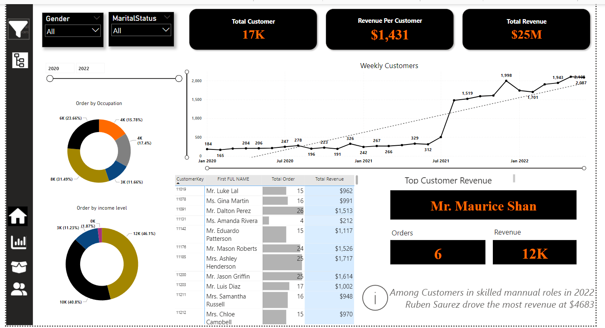

Slide 12

OBSERVATIONS
1. Customer Overview:
- Total Customers: The business served 17,000 customers during the specified period.
- Revenue per Customer: The average revenue per customer stands at $1,431, suggesting a moderate spend per customer.
- Total Revenue: Consistent with other data, the total revenue from customers is $25 million.
.3 Weekly Customer Trends:
- The number of weekly customers shows consistent growth, peaking at 2,087 in early 2022.
The trend line indicates a positive growth trajectory from 184 customers in early 2020 to 1,943 in late 2021.
.2. Customer Segmentation:
- Orders by Occupation: The majority of orders (approximately 47.45%) came from a primary occupation segment, with other significant contributions from two segments at 23.65% and 31.49%.
- Orders by Income Level: The largest customer group by income level, representing 44.15%, was high-income earners, followed by 40.83% in the middle-income bracket and 11.23% in the low-income segment.
4. Top Customer Insights:
- Top Customer: Mr. Maurice Shan led with a total revenue contribution of $12,000 from 6 orders.
- Among customers in skilled manual roles, Ruben Suarez had the highest contribution in 2022, generating $4,683 in revenue.

Slide 13
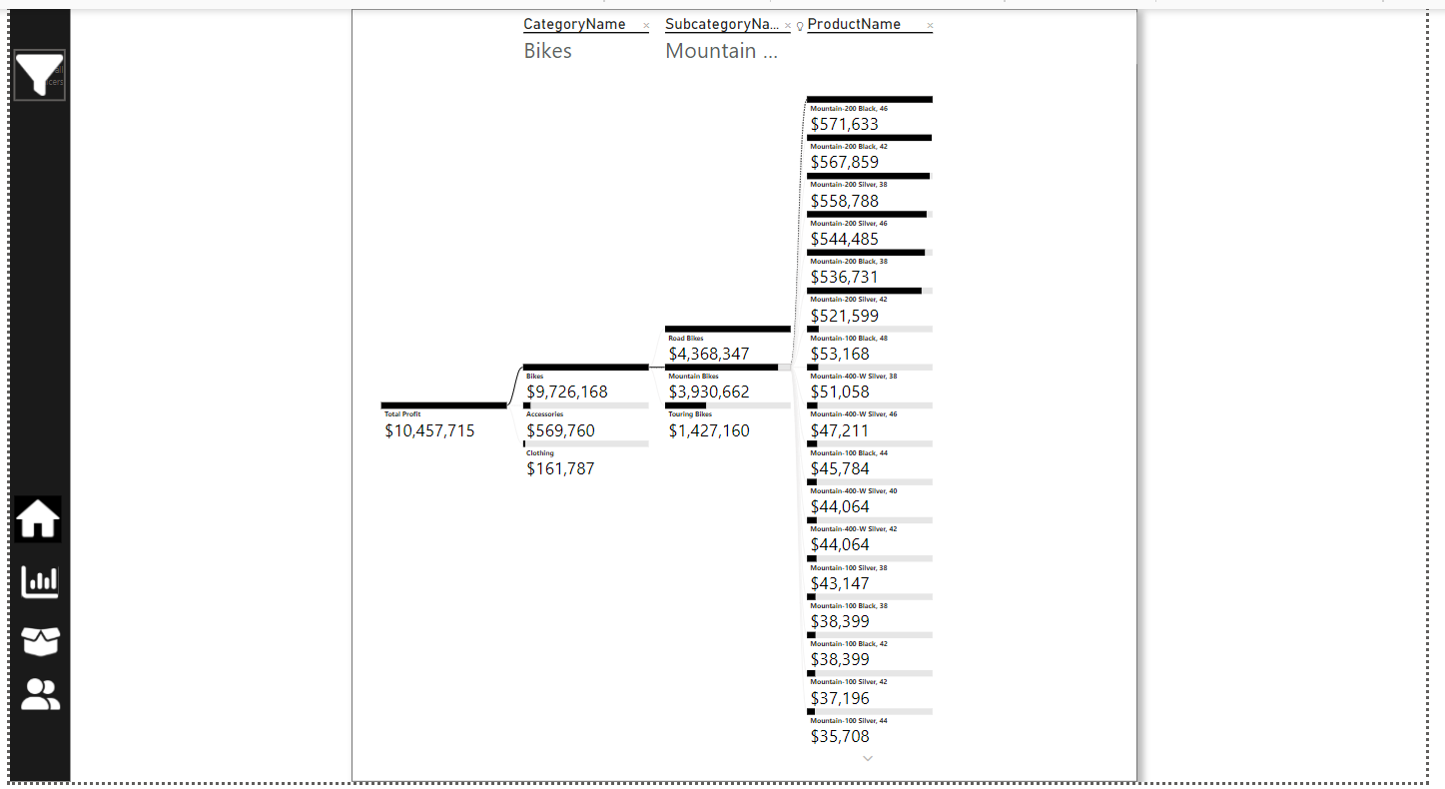
DECOMPOSITION TREE

Slide 14
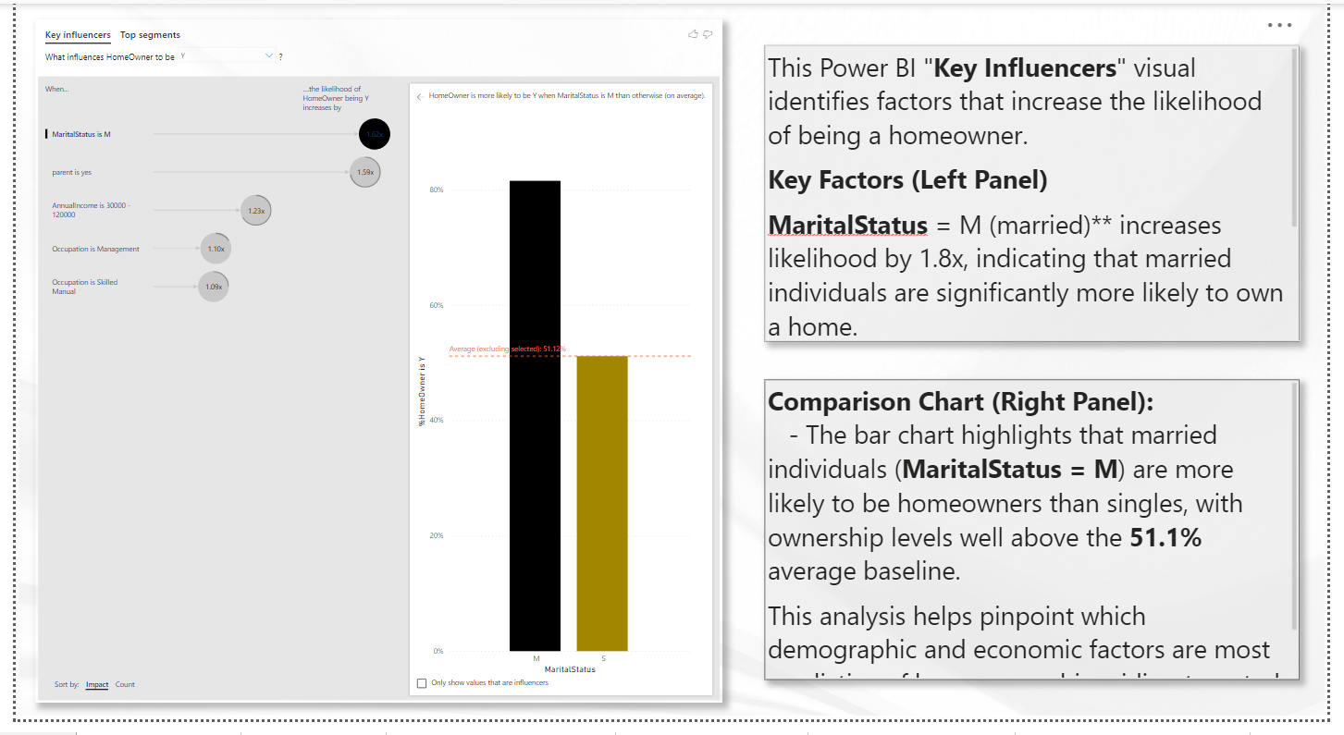
KEY INFLUENCERS

Slide 15

Recommendations
Refine Customer Segmentation and Personalized Engagement
The customer analysis showed that high-income earners account for 44.15% of total orders. Developing tailored marketing strategies for this segment, such as exclusive promotions or loyalty programs, could increase repeat purchases and brand loyalty.
Recommendation : Utilize data-driven insights to create targeted campaigns that resonate with this customer group, leveraging personalized communications that emphasize product quality and value.

Slide 16

Invest in Data-Driven Quality Control Measures
The trends in weekly returns, which spiked at certain points in early and mid-2022, highlight the need for a proactive quality control process. Implementing predictive quality monitoring systems can help detect patterns that lead to increased returns.
Proactive Approach : Leverage machine learning algorithms to identify potential product quality issues before they impact customer satisfaction.
Long-Term Benefit : This predictive capability will not only reduce return rates but also establish Adventure Works as a leader in quality assurance, setting a standard in the industry

Slide 17
Enhance Product Quality and Customer Retention Initiatives
While the overall return rate of 2.17% indicates satisfactory product quality, targeted improvements can lead to even greater customer satisfaction. Products such as the “Sport-100 Helmet,” which showed a higher return rate of 3.33%, should be prioritized. Implementing targeted feedback collection from customers could identify common issues, leading to focused quality enhancements.
Impact : By addressing these concerns proactively, it is estimated that return rates could be reduced by up to 1%, resulting in cost savings, improved customer experience, and strengthened brand reputation.

Slide 18

Enhance Inventory Management Based on Demand Patterns
The insights from the Orders Dashboard revealed that monthly orders (2,146) fell short of the 4,292 target. This signals potential inefficiencies in inventory management or demand forecasting.
Proposed Solution : Introduce predictive analytics tools that use historical data trends to optimize inventory levels and reduce instances of stockouts or overstock. This approach ensures the company can meet customer demand without incurring excess holding costs.

Slide 19




THAT’S A WRAP!
Thankyou for joining me on this journey through the project .👍🏻
I hope you found it informative and thoughtful-provoking.
LinkedIn
For further clarification and inquiries please direct your correspondence to the given details
Github
priyanshikhandelwal2107@gmail.com

